Slide 1
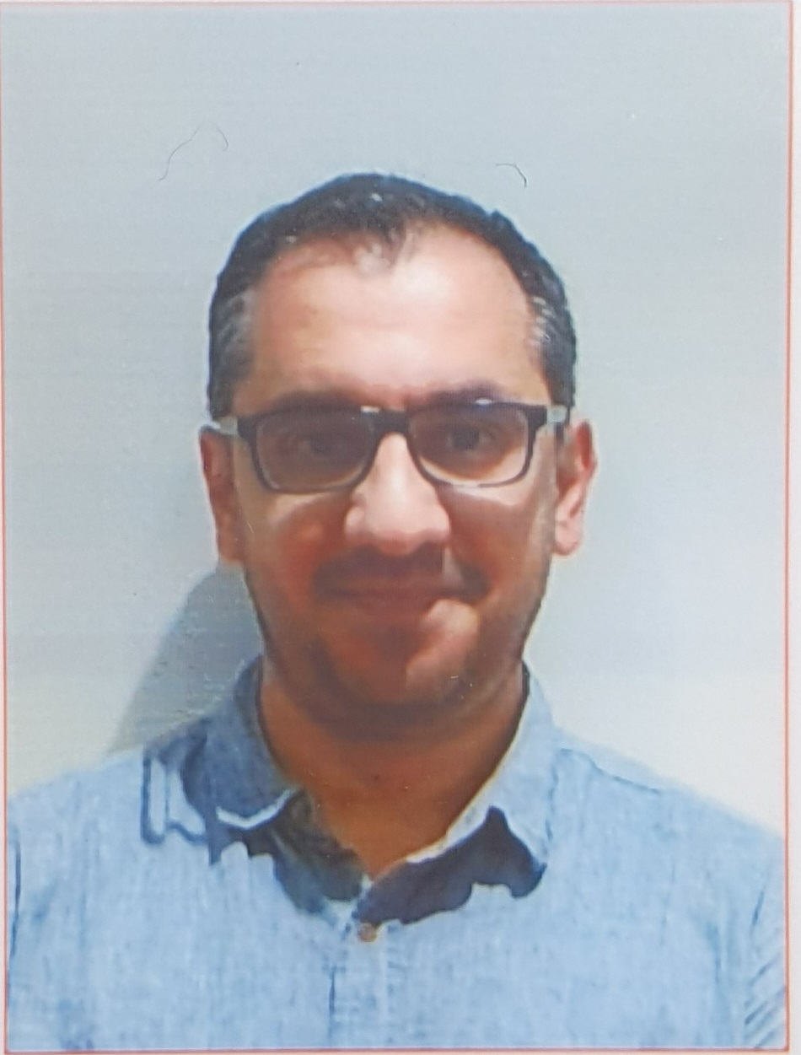
Introduction to Software Engineering (ISE102) Showcase Presentation

Slide 2
Showcase Presentation
Link to join online presentation 28th Oct 6:15 PM – 8:15 PM
Link to join online presentation 31st Oct 12 PM - 2PM
Face-to-Face presentation 4th Nov 4 PM – 6 PM with a link to join online if needed
Face-to-Face presentation 7th Nov 12 PM – 2PM with a link to join online if needed

Slide 3
Link to join online presentation 28th Oct 6:15 PM – 8:15 PM
Here is the link for Tuesday 28th Oct 6:15 PM – 8:15 PM
Online Presentation FSD Tuesday 28th Oct (6:15 PM - 8:15 PM) | Meeting-Join | Microsoft Teams
https://teams.microsoft.com/l/meetup-join/19%3ameeting_YjkwYzFkYWUtZGU4OS00Y2FiLTkyNDEtZmQ3NjczMjBjOWVk%40thread.v2/0?context=%7b%22Tid%22%3a%22e8911c26-cf9f-4a9c-878e-527807be8791%22%2c%22Oid%22%3a%229506d58e-77d8-417d-a0ac-cbcbd8f071a2%22%7d

Slide 4
Link to join online presentation 31st Oct 12 PM - 2PM
Here is the link for Friday 31st Oct 12 PM – 2 PM
Online Presentation FSD Friday 31st Oct (12 PM - 2 PM) | Meeting-Join | Microsoft Teams
https://teams.microsoft.com/l/meetup-join/19%3ameeting_ODRlOTRmNjItNjlhYi00M2JlLTgxNWEtNzlkMjE4N2U4NTc3%40thread.v2/0?context=%7b%22Tid%22%3a%22e8911c26-cf9f-4a9c-878e-527807be8791%22%2c%22Oid%22%3a%229506d58e-77d8-417d-a0ac-cbcbd8f071a2%22%7d

Slide 5
Face-to-Face presentation 4th Nov 4 PM – 6 PM with a link to join online if needed
Tuesday 4th Nov 4 – 6 PM is face-to-face presentation at CB11.B1.403. However, if needed here is the link to join online
Tuesday 4th Nov 4 – 6 PM (Face-to-Face and Online) | Meeting-Join | Microsoft Teams
https://teams.microsoft.com/l/meetup-join/19%3ameeting_YWYwNWU5MjgtYzNhZS00NmJiLTljZWUtMGU5YmZmNmYwMDE4%40thread.v2/0?context=%7b%22Tid%22%3a%22e8911c26-cf9f-4a9c-878e-527807be8791%22%2c%22Oid%22%3a%229506d58e-77d8-417d-a0ac-cbcbd8f071a2%22%7d

Slide 6
Face-to-Face presentation 7th Nov 12 PM – 2 PM with a link to join online if needed
Friday 7th Nov 12 – 2 PM is face-to-face presentation at CB11.B1.401. However, if needed here is the link to join online
Friday 7th Nov 12 PM – 2 PM (Face-to-Face and Online) | Meeting-Join | Microsoft Teams
https://teams.microsoft.com/l/meetup-join/19%3ameeting_NzA2YTNhYWEtNDkxYy00ODg3LTg5ZjYtNTQ2NTU2YmRiNTNi%40thread.v2/0?context=%7b%22Tid%22%3a%22e8911c26-cf9f-4a9c-878e-527807be8791%22%2c%22Oid%22%3a%229506d58e-77d8-417d-a0ac-cbcbd8f071a2%22%7d

Slide 7

Happy Learning and Bright Futures Ahead! Dr. Farshid Keivanian Stay Connected: linkedin.com/in/farshid-keivanian github.com/FarshidKeivanian
Education is the most powerful weapon you can use to change the world. — Nelson Mandela

